Slide 1
Part 5 Django MVT & Templates
Version: 4.0.1
Written and design by: Babar ali

Slide 2
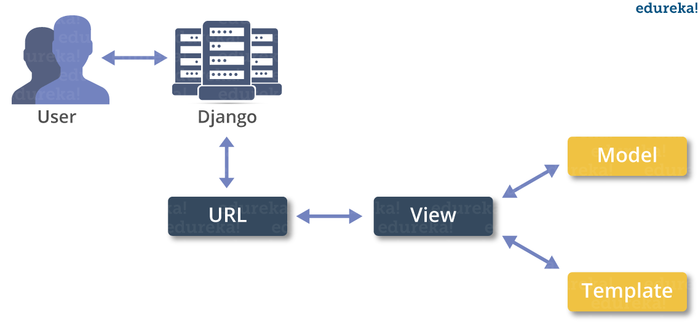
What is MVT in Django?
MVT stands for Model-View-Template. Sometimes it is also referred to as MTV(Model-Template-View). MVT is a design pattern or design architecture that Django follows to develop web applications. It is slightly different from the commonly known MVC(Model-View-Controller) design pattern.
How MVT Works

Slide 3
Model, Views and Templates
The Model manages the data and is represented by a database. A model is basically a database table.
The View receives HTTP requests and sends HTTP responses. A view interacts with a model and template to complete a response.
The Template is basically the front-end layer and the dynamic HTML component of a Django application.

Slide 4
Templates in Django
To configure the Django template system, go to the settings.py file and update the DIRS to the path of the templates folder. Generally, the templates folder is created and kept in the sample directory where manage.py lives. This templates folder contains all the templates you will create in different Django Apps.
Templates
home.html
HTML
about.html
contact.html

Slide 5
How to Add Template in Django Project?
Step No 1
Create a Folder in your project Folder name it as “templates”.
Step No 2
Create an Html file in your template folder name as “home.html”.
Step No 3
Go to setting.py file. Go to Templates then Go to DIRS location and write this…
‘DIRS’ : [os.path.join(BASE_DIR, ‘templates’)]
'DIRS': ['templates'],

Slide 6
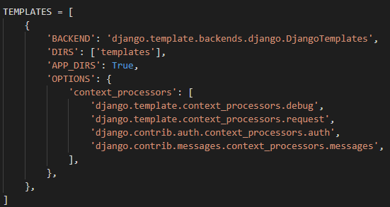
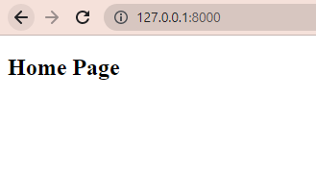
Settings.py file add templates

Slide 7
What is Render Function?
The render() shortcut renders templates with a request context. Template context processors take the request object and return a dictionary which is added to the context.
my_site/views.py
from django.http import HttpResponse
from django.shortcuts import render
# Create your views here.
def home_page(request):
return render(request, 'home.html')

Slide 8
What is loading Template?
To load the template, call get_template() method as we did below and pass template name.
my_site/views.py
from django.http import HttpResponse
from django.shortcuts import render
from django.template import loader
# Create your views here.
def home_page(request):
template = loader.get_template('home.html')
return HttpResponse(template.render())

Slide 9
What is Variable in Django?
Variables associated with a context can be accessed by {{}} (double curly braces). For example, a variable name value is “Rahul”. Then the following statement will replace name with its value.
my_site/views.py
from django.http import HttpResponse
from django.shortcuts import render
# Create your views here.
def home_page(request):
name = {'student': 'Rahul', 'Age': 20, 'Gender': 'Male'}
return render(request, 'home.html', name)

Slide 10
Access variable in HTML page
If you want to access the variable name in HTML page using double <curly brackets>.
The following method show how to access Django function variable in HTML page.
my_site/template/home.html
<body>
<h2> Home Page </h2>
<h3> Your Name is : <b style="color: red;"> {{student}} </b> </h3>
<h3> Your Age : <b style="color: red;"> {{Age}} </b> </h3>
<h3> Your Gender : <b style="color: red;"> {{Gender}} </b> </h3>
</body>

Slide 11
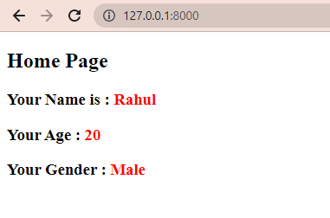
Screen shot
The output is look like this:

Slide 12
Thanks for Reading

